Slide 1
Troubleshooting Hardware Issues
Lesson 5

Slide 2
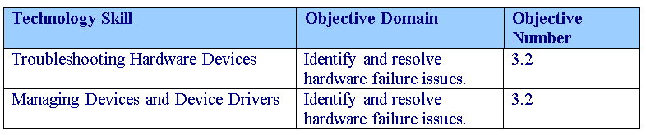
Objectives
Notes:
Outline the material you are going to cover in this lesson. Do not go into detail; each of these points will be expanded on in the lesson. You may also want to mention the Technology Skills that are being covered for the Certification exam.

Slide 3
Troubleshooting Hardware Devices
Every time you turn on a computer, the computer goes through the power-on self-test (POST), which initializes hardware and finds an operating system to load.

Slide 4
ROM BIOS
Remember that the ROM BIOS is firmware that occupies a spot halfway between software and hardware.
To overcome some problems, you would have to check with your system or motherboard manufacturer to see if they have a new version of your BIOS that you can download and apply to your system.
The process of updating your system ROM BIOS is called flashing the BIOS.

Slide 5
Windows Memory Diagnostic
Memory problems can be caused by faulty RAM or a faulty motherboard.
Unfortunately, these problems can sometimes be difficult to confirm without special tools. Like Windows Vista, Windows 7 includes the Memory Diagnostic Tool.

Slide 6
Power Problems
The power supply is as important as the processor, memory, and motherboard because these need power to operate.
Without power, entire system would fail, including not being able to boot, the system locking up, or the system rebooting randomly.

Slide 7
Power Problems
One of the scenarios that you may deal with is that there are no running fans, lights, sounds, or signs of movement when you attempt to start the computer.
This problem can be caused by a faulty component, like the processor, RAM, motherboard, or power supply, or possibly another device that is causing a short, overload, or power problem.
If your computer reboots before completing boot up or shuts down before boot, you should verify that your power supply can deliver enough power to all of your devices.

Slide 8
Testing Drives
When a drive cannot be found during boot up, you will receive disk errors during POST or receive disk read or write errors.
You could have a faulty drive, drive cable, or controller (found on its own expansion card or built into the motherboard).
Windows includes two useful tools to check disks including error-checking and defragmentation tools.

Slide 9
Testing Drives
You can solve some computer problems and improve the performance of your computer just by making sure that your hard disk has no errors.
To test your hard disk, use the graphical Error-checking tool or the chkdsk command at the command prompt.

Slide 10
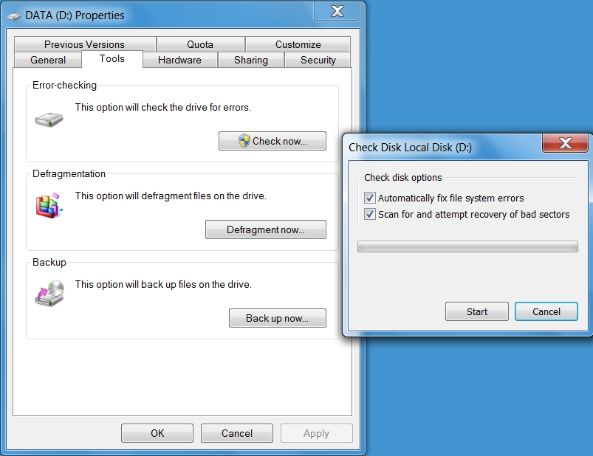
Testing Drives

Slide 11
Disk Defragmenter
Fragmentation makes your hard disk do extra work that can slow down your computer.
Disk Defragmenter rearranges fragmented data so your disks and drives can work more efficiently.
Disk Defragmenter runs on a schedule, but you can also analyze and defragment your disks and drives manually.

Slide 12
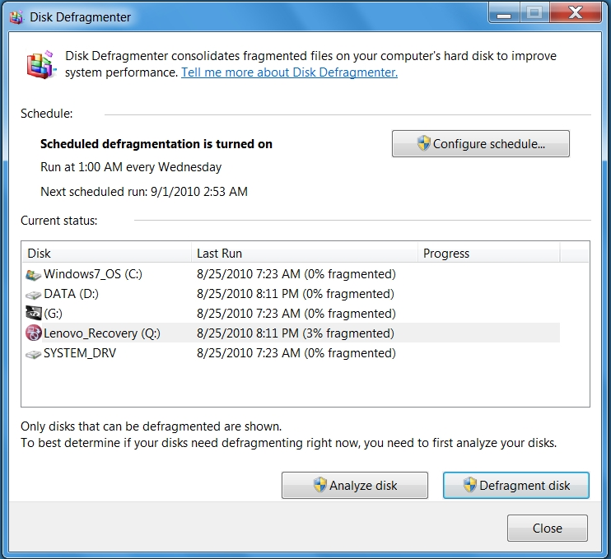
Disk Defragmenter

Slide 13
Troubleshooting Ports, Video, and Sound
The other common devices that may fail are ports, video systems, and sound systems.
Unlike the motherboard, RAM, and processors, these devices don’t usually cause the system not to boot unless the device is causing a short or overload.

Slide 14
Devices and Device Drivers
Since a computer running Windows 7 can have a wide array of devices, it can sometimes be a challenge to make all devices operate correctly especially since some specialized computers can have non-standard hardware that may require you to manually install or update drivers.
Device drivers are programs that control a device.
You can think of them as translators between the device and the operating system and programs that use the device.

Slide 15
Plug and Play (PnP)
For years, Windows has benefited from Plug and Play (PnP), a technology that allows you to install or connect a device, have the device automatically recognized and configured with the appropriate driver installed.
Today, this technology has been expanded beyond expansion cards to include other technologies.

Slide 16
Device Resources
Interrupt request (IRQ) line numbers: A signal sent by a device to get the attention of the processor when the device is ready to accept or send information. Each device must be assigned a unique IRQ number.
Direct memory access (DMA) channels: Memory access that does not involve the processor.

Slide 17
Device Resources
Input/output (I/O) port addresses: A channel through which data is transferred between a device and the processor. The port appears to the processor as one or more memory addresses that it can use to send or receive data.
Memory address ranges: A portion of computer memory that can be allocated to a device and used by a program or the operating system. Devices are usually allocated a range of memory addresses.

Slide 18
Signed Driver
A signed driver is a device driver that includes a digital signature, which is an electronic security mark that can indicate the publisher of the software and provide information that can show if a driver has been altered.
When signed by Microsoft, a driver has been thoroughly tested to make sure that it will not cause problems with the system’s reliability or security.

Slide 19
Signed Drivers
Drivers that are included on the Windows installation DVD or downloaded from Microsoft’s update website are digitally signed.
A driver that lacks a valid digital signature, or was altered after it was signed, cannot be installed on 64-bit versions of Windows.
If you have problems with a device driver, you should only download drivers from Microsoft’s update website or the manufacturer’s website.
If you are using a 32 bit version of Windows you can use the File Signature Verification program (Sigverif.exe) to check for unsigned device drivers in the system area of a computer.

Slide 20
Devices and Printers Folders
The Devices and Printers folder gives you a quick view of all the devices currently connected to your computer that you can connect or disconnect through a port or network connection.
This includes mobile devices such as music players, digital cameras, USB devices, and network devices.
It does not include items installed inside your computer such as internal disk drives, expansion cards, and RAM, and it will not display legacy devices such as keyboards and mice connected through a PS/2 or serial port.

Slide 21
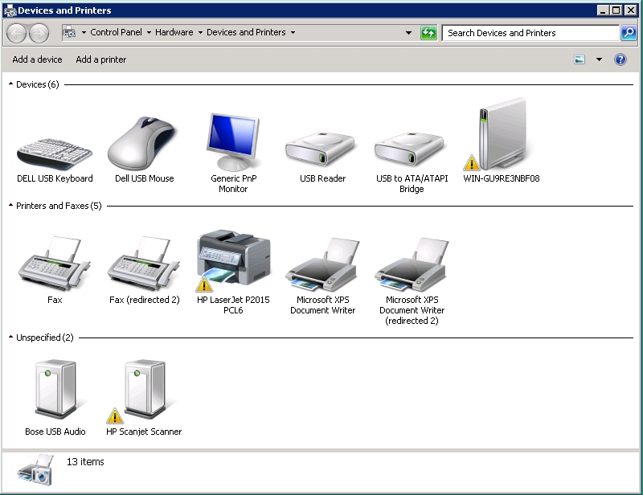
Devices and Printers Folders

Slide 22
Device Manager
Device Manager provides you with a graphical view of the hardware (internal and external) that is installed your computer and gives you a way to manage and configure your devices.
With Device Manager, you can determine whether a device is recognized by Windows and if the device is working properly.
You can also enable, disable, or uninstall the device, roll back the previous version of the driver, identify the device driver including its version, and change hardware configuration settings.

Slide 23
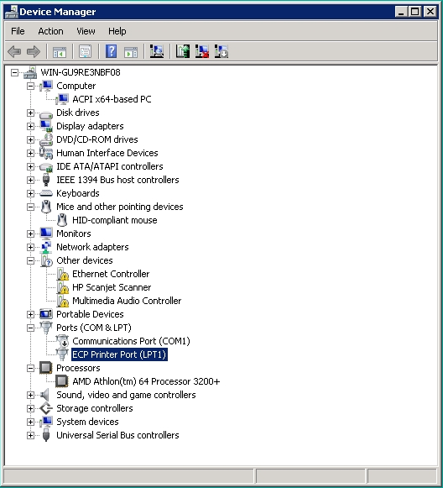
Device Manager

Slide 24
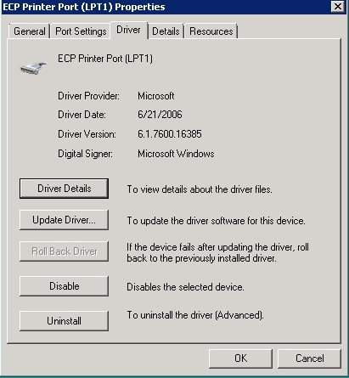
Device Manager

Slide 25
Device Manager
A downward pointing black arrow indicates a disabled device. A disabled device is a device that is physically present in the computer and is consuming resources, but does not have a driver loaded.
A black exclamation point (!) on a yellow field indicates the device is in a problem state.
You also need to check whether any devices are listed as an unknown device, listed under Other devices, or has a generic name such as Ethernet Controller or PCI Simple Communications Controller, which indicates that the proper driver is not loaded.

Slide 26
Skill Summary
Every time you turn on a computer, the computer goes through the power-on self-test (POST), which initializes hardware, tests basic hardware devices, and finds an operating system to load.
If the processor, motherboard, or RAM is faulty, it can cause the entire system to fail. Specific symptoms may include an inability to boot, system lock-ups, or random reboots.

Slide 27
Skill Summary
If there are no running fans, flashing lights, audible sounds, or signs of movement when you attempt to start the computer. It is probably caused by a faulty component, such as a processor, RAM, motherboard, or power supply.
If Windows detects possible problems with your computer’s memory, it will prompt you to run the Memory Diagnostics Tool.
Windows includes two useful tools to check disks including Error-checking and Defragmentation tools.
Notes:
Review the Skill Summary to wrap up your lesson.

Slide 28
Skill Summary
You can solve some computer problems and improve the performance of your computer just by making sure that your hard disk has no errors using the Error-checking tool.
Fragmentation makes your hard disk do extra work that can slow down your computer. Removable storage devices such as USB flash drives can also become fragmented.
Disk Defragmenter rearranges fragmented data so your disks and drives can work more efficiently.

Slide 29
Skill Summary
When troubleshooting devices connected through ports, the video system, or the sound system, you need to verify that the related devices are connected properly, turned on, and the correct driver is loaded.
Device drivers are programs that control a device. You can think of them as a translator between the device and the operating system and programs that use that device.
To prevent you from constantly inserting the Windows 7 installation DVD, Windows 7 includes a driver store with an extensive library of device drivers.

Slide 30
Skill Summary
For years, Windows has benefited from Plug and Play (PnP), which means the device is automatically recognized, automatically configured, and the appropriate driver installed when you install or connect a device.
A signed driver is a device driver that includes a digital signature, which is an electronic security mark that can indicate the publisher of the software and provides information that can show if a driver has been altered.
All installed drivers in the 64-bit version of Windows 7 are required to be signed and unaltered.

Slide 31
Skill Summary
The Devices and Printers folder gives you a quick view of devices connected to your computer that you can connect or disconnect through a port or network connection.
Device Manager provides you with a graphical view of the hardware (internal and external) that is installed your computer and gives you a way to manage and configure your devices.

